Slide 1
ChatConnect - A Real-Time Chat and Communication App
Rahulgandhi M - 839103D515269069F054DEC6288994A9
Aswin Kumar M - B5985133A023045B96B47BBDF2895617
Kirthik Kumar S - 5D44D06C376B43381AF4A4BD5A992D3F
Vimal B - D9D3DC8364F7011BEDC48804DD57F7FD

Slide 2
DESCRIPTION
ChatConnect is a sample project designed to demonstrate the creation of a real-time chat app using the Android Compose UI toolkit. This project utilizes Compose libraries to develop a simple, interactive chat application where users can send and receive text messages. The app highlights Compose's declarative UI, state management, and composable functions, demonstrating efficient handling of user input, navigation, and Firebase integration to populate the UI with real-time data. Scoreboard: A prominent feature of any cricket ground, the scoreboard displays the current score, number of wickets fallen, overs bowled, and other relevant details. It may be electronic or manual, depending on the level of the match.
Key Features:
Declarative UI: Uses Compose’s declarative functions to create and update the app interface efficiently.
State Management: Implements state management to maintain app responsiveness and user interactions.
Firebase Integration: Uses Firebase for user authentication and real-time database to store and retrieve messages.
Composable Functions: Each UI component is defined as a reusable composable function, making it easy to build and modify the interface.
Learning Outcomes:
By the end of this project:
You’ll know how to work with Android Studio to build an app.
You’ll be able to integrate a backend database for authentication and data storage.
Project Workflow:
User Registration: Users create an account within the app.
User Login: After registration, users log in to access chat features.
Main Chat Page: Users enter the main chat interface to start conversations.

Slide 3
Main Activity.kt :
package com.project.pradyotprakash.flashchat
import android.os.Bundle
import androidx.activity.ComponentActivity
import androidx.activity.compose.setContent
import com.google.firebase.FirebaseApp
class MainActivity : ComponentActivity() {
override fun onCreate(savedInstanceState: Bundle?) {
super.onCreate(savedInstanceState)
FirebaseApp.initializeApp(this)
setContent {
NavComposeApp()
}
}
}

Slide 4
NavComposeApp.kt :
package com.project.pradyotprakash.flashchat
import androidx.compose.runtime.Composable
import androidx.compose.runtime.remember
import androidx.navigation.compose.NavHost
import androidx.navigation.compose.composable
import androidx.navigation.compose.rememberNavController
import com.google.firebase.auth.FirebaseAuth
import com.project.pradyotprakash.flashchat.nav.Action
import com.project.pradyotprakash.flashchat.nav.Destination.AuthenticationOption
import com.project.pradyotprakash.flashchat.nav.Destination.Home
import com.project.pradyotprakash.flashchat.nav.Destination.Login
import com.project.pradyotprakash.flashchat.nav.Destination.Register
import com.project.pradyotprakash.flashchat.ui.theme.FlashChatTheme
import com.project.pradyotprakash.flashchat.view.AuthenticationView
import com.project.pradyotprakash.flashchat.view.home.HomeView
import com.project.pradyotprakash.flashchat.view.login.LoginView
import com.project.pradyotprakash.flashchat.view.register.RegisterView

Slide 5
@Composable
fun NavComposeApp() {
val navController = rememberNavController()
val actions = remember(navController) { Action(navController) }
FlashChatTheme {
NavHost(
navController = navController,
startDestination =
if (FirebaseAuth.getInstance().currentUser != null)
Home
else
AuthenticationOption
) {
composable(AuthenticationOption) {
AuthenticationView(
register = actions.register,
login = actions.login
)

Slide 6
}
composable(Register) {
RegisterView(
home = actions.home,
back = actions.navigateBack
)
}
composable(Login) {
LoginView(
home = actions.home,
back = actions.navigateBack
)
}
composable(Home) {
HomeView()
}
}
}
}

Slide 7
Constants.kt :
package com.project.pradyotprakash.flashchat
object Constants {
const val TAG = "flash-chat"
const val MESSAGES = "messages"
const val MESSAGE = "message"
const val SENT_BY = "sent_by"
const val SENT_ON = "sent_on"
const val IS_CURRENT_USER = "is_current_user"
}

Slide 8
Navigation.kt :
package com.project.pradyotprakash.flashchat.nav
import androidx.navigation.NavHostController
import com.project.pradyotprakash.flashchat.nav.Destination.Home
import com.project.pradyotprakash.flashchat.nav.Destination.Login
import com.project.pradyotprakash.flashchat.nav.Destination.Register
object Destination {
const val AuthenticationOption = "authenticationOption"
const val Register = "register"
const val Login = "login"
const val Home = "home"
}

Slide 9
class Action(navController: NavHostController) {
val home: () -> Unit = {
navController.navigate(Home) {
popUpTo(Login) {
inclusive = true
}
popUpTo(Register) {
inclusive = true
}
}
}
val login: () -> Unit = { navController.navigate(Login) }
val register: () -> Unit = { navController.navigate(Register) }
val navigateBack: () -> Unit = { navController.popBackStack() }
}

Slide 10
AuthenticationOption.kt :
package com.project.pradyotprakash.flashchat.view
import androidx.compose.foundation.layout.Arrangement
import androidx.compose.foundation.layout.Column
import androidx.compose.foundation.layout.fillMaxHeight
import androidx.compose.foundation.layout.fillMaxWidth
import androidx.compose.foundation.shape.RoundedCornerShape
import androidx.compose.material.*
import androidx.compose.runtime.Composable
import androidx.compose.ui.Alignment
import androidx.compose.ui.Modifier
import androidx.compose.ui.graphics.Color
import com.project.pradyotprakash.flashchat.ui.theme.FlashChatTheme

Slide 11
@Composable
fun AuthenticationView(register: () -> Unit, login: () -> Unit) {
FlashChatTheme {
// A surface container using the 'background' color from the theme
Surface(color = MaterialTheme.colors.background) {
Column(
modifier = Modifier
.fillMaxWidth()
.fillMaxHeight(),
horizontalAlignment = Alignment.CenterHorizontally,
verticalArrangement = Arrangement.Bottom
) {
Title(title = "⚡️ Chat Connect")
Buttons(title = "Register", onClick = register, backgroundColor = Color.Blue)
Buttons(title = "Login", onClick = login, backgroundColor = Color.Magenta)
}
}
}
}

Slide 12
Widgets.kt :
package com.project.pradyotprakash.flashchat.view
import androidx.compose.foundation.layout.fillMaxHeight
import androidx.compose.foundation.layout.fillMaxWidth
import androidx.compose.foundation.layout.padding
import androidx.compose.foundation.shape.RoundedCornerShape
import androidx.compose.foundation.text.KeyboardOptions
import androidx.compose.material.*
import androidx.compose.material.icons.Icons
import androidx.compose.material.icons.filled.ArrowBack
import androidx.compose.runtime.Composable
import androidx.compose.ui.Modifier
import androidx.compose.ui.graphics.Color
import androidx.compose.ui.text.font.FontWeight
import androidx.compose.ui.text.input.KeyboardType
import androidx.compose.ui.text.input.VisualTransformation
import androidx.compose.ui.text.style.TextAlign
import androidx.compose.ui.unit.dp
import androidx.compose.ui.unit.sp
import com.project.pradyotprakash.flashchat.Constants

Slide 13
@Composable
fun Title(title: String) {
Text(
text = title,
fontSize = 30.sp,
fontWeight = FontWeight.Bold,
modifier = Modifier.fillMaxHeight(0.5f)
)
}
// Different set of buttons in this page
@Composable
fun Buttons(title: String, onClick: () -> Unit, backgroundColor: Color) {
Button(
onClick = onClick,
colors = ButtonDefaults.buttonColors(
backgroundColor = backgroundColor,
contentColor = Color.White
),
modifier = Modifier.fillMaxWidth(),
shape = RoundedCornerShape(0),

Slide 14
) {
Text(
text = title
)
}
}
@Composable
fun Appbar(title: String, action: () -> Unit) {
TopAppBar(
title = {
Text(text = title)
},
navigationIcon = {
IconButton(
onClick = action
) {
Icon(
imageVector = Icons.Filled.ArrowBack,
contentDescription = "Back button"
)
}
}
)
}
@Composable
fun TextFormField(value: String, onValueChange: (String) -> Unit, label: String, keyboardType: KeyboardType, visualTransformation: VisualTransformation) {
OutlinedTextField(
value = value,
onValueChange = onValueChange,
label = {
Text(
label
)
},
maxLines = 1,
modifier = Modifier
.padding(horizontal = 20.dp, vertical = 5.dp)
.fillMaxWidth(),
keyboardOptions = KeyboardOptions(
keyboardType = keyboardType
),
singleLine = true,
visualTransformation = visualTransformation
)
}
@Composable
fun SingleMessage(message: String, isCurrentUser: Boolean) {
Card(
shape = RoundedCornerShape(16.dp),
backgroundColor = if (isCurrentUser) MaterialTheme.colors.primary else Color.White
) {
Text(
text = message,
textAlign =
if (isCurrentUser)
TextAlign.End
else
TextAlign.Start,
modifier = Modifier.fillMaxWidth().padding(16.dp),
color = if (!isCurrentUser) MaterialTheme.colors.primary else Color.White
)
}
}

Slide 16
app:layout_constraintVertical_bias="0.85" />
<EditText
android:id="@+id/over"
android:layout_width="143dp"
android:layout_height="65dp"
android:layout_marginStart="244dp"
android:layout_marginLeft="244dp"
android:layout_marginBottom="16dp"
android:ems="10"
android:inputType="number"
android:text="@string/_0"
android:textColor="@color/DarkRed"
android:textSize="28sp"
android:textStyle="bold"
app:layout_constraintBottom_toBottomOf="parent"
app:layout_constraintStart_toStartOf="parent" />
<Button
android:id="@+id/button2"
android:layout_width="wrap_content"
android:layout_height="wrap_content"
android:text="OUT"
android:textColor="@color/BlueViolet"
android:textSize="28sp"
app:layout_constraintBottom_toBottomOf="parent"

Slide 17
app:layout_constraintEnd_toEndOf="parent"
app:layout_constraintHorizontal_bias="0.467"
app:layout_constraintStart_toStartOf="parent"
app:layout_constraintTop_toTopOf="parent"
app:layout_constraintVertical_bias="0.547" />
<Button
android:id="@+id/convert"
android:layout_width="203dp"
android:layout_height="76dp"
android:text="Convert In Overs"
android:textColor="@color/Blue"
android:textSize="20sp"
app:layout_constraintBottom_toBottomOf="parent"
app:layout_constraintEnd_toStartOf="@+id/textView"
app:layout_constraintHorizontal_bias="0.39"
app:layout_constraintStart_toStartOf="parent"
app:layout_constraintTop_toBottomOf="@+id/no"
app:layout_constraintVertical_bias="0.119" />
<EditText
android:id="@+id/covertedresult"
android:layout_width="141dp"
android:layout_height="63dp"
android:ems="10"
android:inputType="textPersonName"

Slide 18
android:text="0"
android:textColor="@color/DarkRed"
android:textSize="25sp"
app:layout_constraintBottom_toBottomOf="parent"
app:layout_constraintEnd_toStartOf="@+id/over"
app:layout_constraintHorizontal_bias="0.339"
app:layout_constraintStart_toStartOf="parent"
app:layout_constraintTop_toTopOf="parent"
app:layout_constraintVertical_bias="0.962" />
<EditText
android:id="@+id/extra"
android:layout_width="100dp"
android:layout_height="78dp"
android:ems="10"
android:inputType="textPersonName"
android:text="@string/_0"
android:textColor="@color/DarkGoldenrod"
android:textSize="15sp"
android:textStyle="bold"
app:layout_constraintBottom_toBottomOf="@+id/over"
app:layout_constraintEnd_toEndOf="parent"
app:layout_constraintHorizontal_bias="0.935"
app:layout_constraintStart_toStartOf="parent"
app:layout_constraintTop_toTopOf="parent"

Slide 19
app:layout_constraintVertical_bias="0.78" />
<Button
android:id="@+id/button3"
android:layout_width="wrap_content"
android:layout_height="wrap_content"
android:text="Extras"
android:textStyle="bold"
app:layout_constraintBottom_toBottomOf="parent"
app:layout_constraintEnd_toEndOf="parent"
app:layout_constraintHorizontal_bias="0.913"
app:layout_constraintStart_toStartOf="parent"
app:layout_constraintTop_toTopOf="parent"
app:layout_constraintVertical_bias="0.669" />
</androidx.constraintlayout.widget.ConstraintLayout>

Slide 20
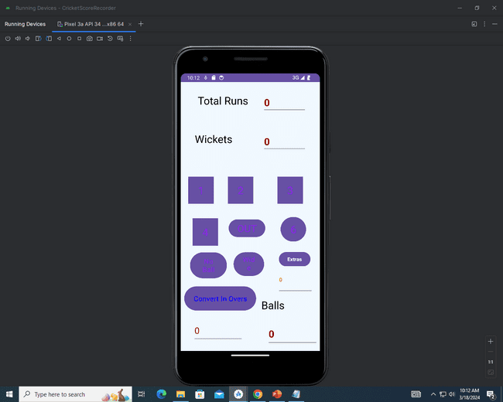
OUTPUT:

Slide 21
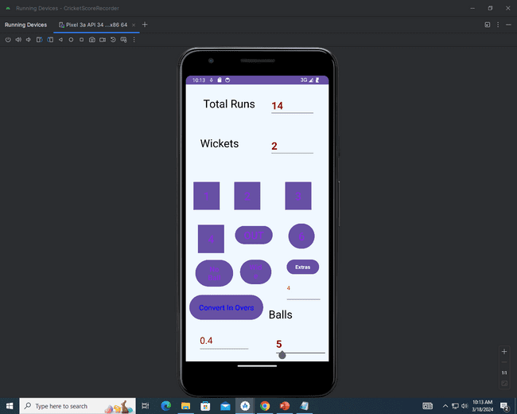

Slide 22
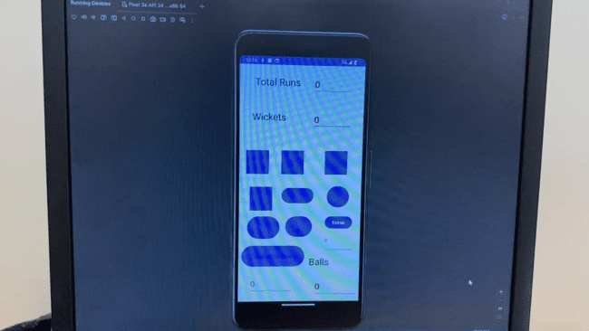

Slide 23
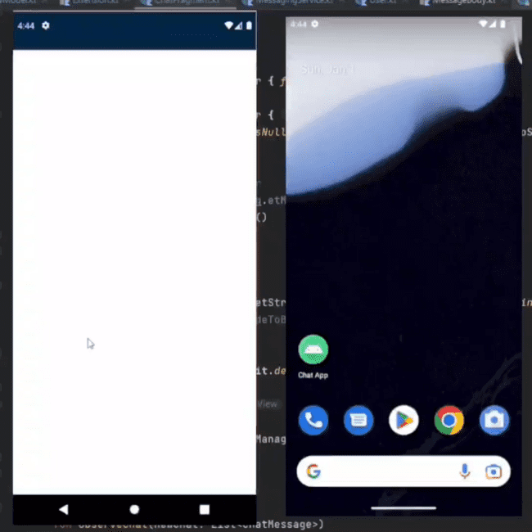
DEMO VIDEO

